Slide 1
Telling your story: CV and personal statement for promotion
Gustavo Arrizabalaga, PhD
Senior Associate Dean for Faculty Affairs

Slide 2
Key topics for today
The promotion workflow
The CV format and content
The personal statement

Slide 3
The promotion and tenure workflow
All tracks
Department Promotions Committee
Vote
Jacobs School ad hoc Promotions Committee
Vote
Candidate prepares CV and statement
Internal and external evaluators
Department Chair*
Jacobs School Dean*
Tenured, tenure track, and research track going from Associate to Professor
President’s Review Board*
UB Provost*
UB President*
SUNY Chancellor*
Lots of people will be writing letters about you!!!
* Faculty candidate receives letter

Slide 4

What makes your job easier?
Think about times you have been an evaluator
(Student essays, letters of reference, residents, grants, manuscripts)

Slide 5
What makes the reviewer’s job easier?
Clear and well-organized materials
Easy to find key items
Consistent format
Concise and precise language
Easy to follow narrative (no excessive jargon or field-specific language)
Unfamiliar concepts are explained and clarified

Slide 6
The purpose of your CV and personal statement
Provide concrete evidence of excellence in research, teaching, and service
Describe your professional arc and focus
Describe specific achievements in research, teaching, and service
Show evidence of national/international reputation
Tell your story!

Slide 7
Your CV

Slide 8
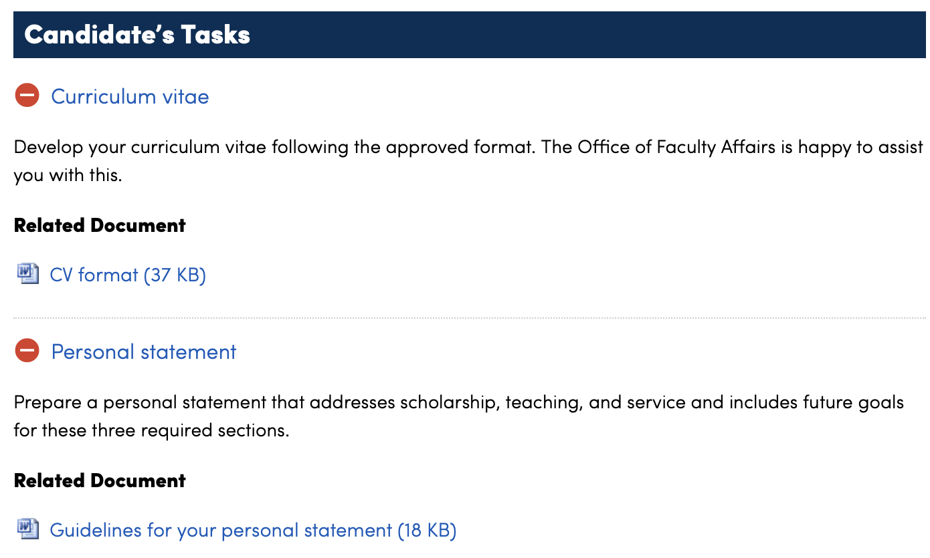
Your CV – helpful tips
https://medicine.buffalo.edu/offices/faculty-affairs/faculty-promotion.html
Use the official University of Buffalo format
(example template on our website)
No page limit, use font 11 or larger
Reverse chronological order is preferred (consistency is key)
Do not include personal information
If you use notations (*, #, etc define them at the beginning)
Key sections that must be included:
name, address, and current position, education, employment history, awards and honors, professional memberships, boards and certifications, invited presentations, service activities, educational activities, research activities

Slide 9
Your CV: Tips for biographical and professional info
name, address, and current position, education, employment history, awards and honors, professional memberships, boards and certifications, invited presentations
No personal information (country of birth, citizenship, marital status, etc)
Use correct faculty title (i.e. Associate Professor, Clinical Assistant Professor, etc)
We are Jacobs School of Medicine and Biomedical Sciences at the University at Buffalo
List the department, not just your division
For awards, spell out all abbreviations and indicate what the award was for
Invited presentations are those that you are invited to deliver, not ones that you were selected through an abstract submission

Slide 10
Your CV: service and teaching
Divide the service section into 5 categories: service to the profession, university, college, departmental, and community service
Divide teaching activities into courses taught (didactic and clinical), research supervision, and mentorship
Courses taught should be listed by course with inclusive dates (e.g. from 2018 to now)
Useful to include number of contact hours and learners
In research supervision, list students and trainees that you have directly supervised (include if they have published, presented, received fellowships, or awards and where they are now if known)

Slide 11
Examples of teaching sections:
Your teaching section could look like this:
Course | Topic | Date | # of trainees | # of in-class contact hours
Pediatric Hematology/Oncology Fellow Lectures | Non-Hodgkin Lymphoma | 3/12/2021 | 1 | 1
Pediatric Hematology/Oncology Fellow Lectures | Pediatric Neurooncology | 10/23/2020 | 2 | 1
Pediatric Resident Lecture Series | Pediatric Neurooncology | 6/11/2020 | 45 | 1
Pediatric Hematology/Oncology Fellow Lectures | Work-up of a New Leukemia Patient | 9/6/2019 | 2 | 1
Pediatric Hematology/Oncology Fellow Lectures | Immunotherapy for Pediatric Malignancies, Part 2 | 8/9/2019 | 2 | 1
Pediatric Hematology/Oncology Fellow Lectures | Immunotherapy for Pediatric Malignancies, Part 1 | 5/17/2019 | 3 | 1
Pediatric Resident Lecture Series | Pediatric Leukemia | 2/14/2019 | 45 | 1
Pediatric Resident Lecture Series | Leukemia and Lymphoma | 2/11/2016 | 45 | 1
Pediatric Resident Lecture Series | Leukemia | 4/10/2014 | 45 | 1

Slide 12
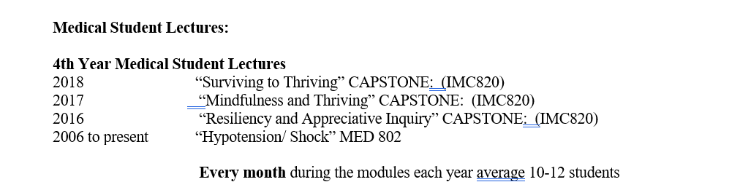
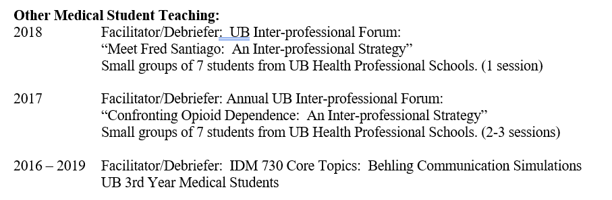
Teaching section examples, cont.
Course # | Name | Semester | Notes
BSC 1005 | Big Ideas in Biology | S 2018 F 2018 S 2019 F 2019 | New course Received Global Learning designation Received LA funding for 3 semesters Implemented active learning Published curriculum and data
BSC 3930 | Discovery 2 | S 2018 F 2018 S 2019 | New course Implemented active learning
BSC 3910 | Research Methods | F 2017 | Course redesign Implemented active learning
BSC 4931 | Senior Seminar | S 2020 F 2020 S 2021 S2022 F 2022 S 2023 | Course redesign Implemented active learning Published curriculum and data
BSC 3848 | Scientific Literacy: Integrating Biological Content and Skills | F 2021 S 2022 F 2022 S 2023 | New course Designed to be online, asynchronous

Slide 13


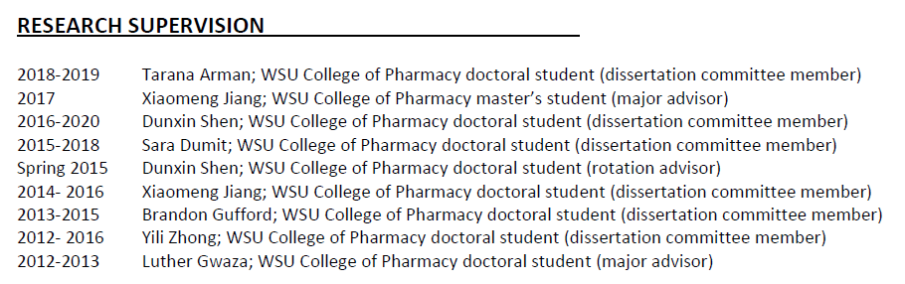
Teaching examples, cont.
Remember to list any students and trainees that you have directly supervised!
Check out some of these examples of how other faculty have structured their research supervision sections!

Slide 14
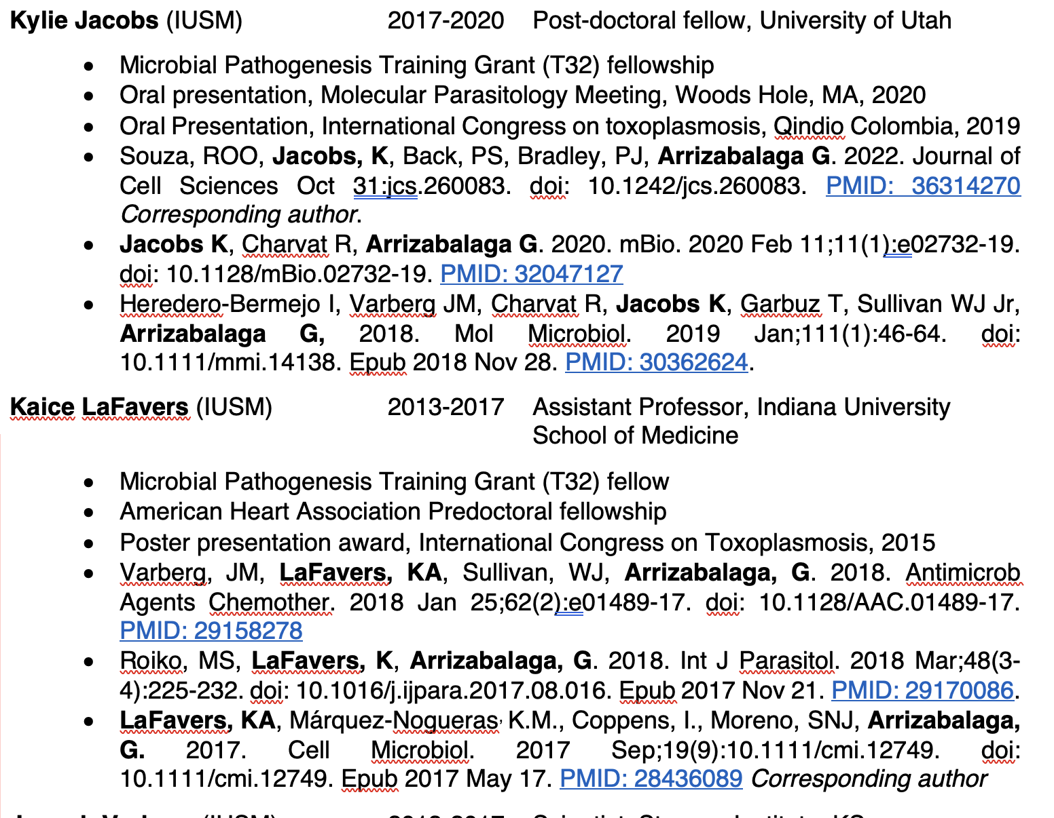
Publication examples

Slide 15
Your CV: research and scholarship
Include an introductory paragraph describing the focus of your scholarship. You can summarize and total scholarly products (i.e. funding and publications)
For grants: include name, ID, agency and mechanism, your role, and the total amount of money (and % effort) towards your research work. Use the accurate name for the role as established by the granting agency (i.e. for NIH PI, mPI, co-I, consultant, etc)
For publications: provide a link to your full bibliography (e.g. My Profile from Google Scholar, ORCID, etc.)
Divide publications into published or submitted, peer reviewed or non-peer reviewed, research articles or book chapters (see template on our website)
Use complete citations with authors, title, full journal name, date ,volume, issue, and inclusive page numbers, make your name bold
Indicate role in publications (e.g. corresponding author, if middle author what did you do, etc.)

Slide 16
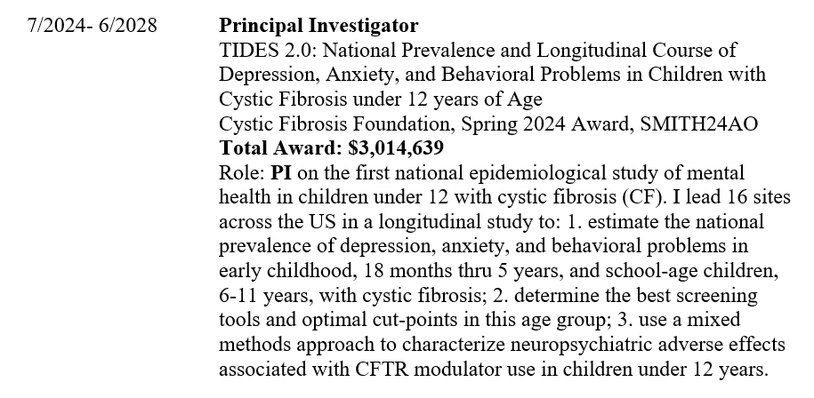
Grants example
Check out this example of a grant on a CV.
The name and date are both clearly identified.
Notice how the role is indicated at the top and a more in-depth description is given below.
Total award amount is clearly indicated.

Slide 17

Your CV: annotations as your friend
Annotations in both publications and grants can be very useful for the reviewers
What was your role in a grant? Did a publication include a trainee? What was your contribution to a publication?
Some funding mechanisms might be unfamiliar to reviewers, explain them!
Don’t forget to include your role! Use a key to indicate any trainees!

Slide 18
Your CV: Clinical trials
Include clinical trials as part of your research/scholarly funding
Indicate total amount of money allocated to the trial
Clearly explain your role stressing your leadership in the trial. (e.g. explain site PI)
Indicate scholarly products, treatments, guidelines that are associated with the trial

Slide 19
Updating your CV
Your CV can be updated throughout the process (the only document that can be updated)
This can be helpful when you get new publications, grants, awards, etc
When updating highlight any new additions or changes in yellow and write the update date at the beginning of the CV
The updated CV gets added to the dossier, the old CV remains

Slide 20
Your Personal Statement

Slide 21
Your personal statement - guidelines
A narrative that tells your story and highlights your achievements in research, teaching, and service
8 pages limit (11 points font, single spaced)
Organization is up to you but typically includes a one paragraph introduction and separate sections for scholarship/research, teaching, and service.
You can use tables, charts, and figures, if it helps with clarity
Everything that you have done professionally matter. Highlight what you have done in rank.
Your Personal Statement should reflect your career highlights, the context and impact of your work, and what you are passionate about in your professional career. It should not be a review of your CV.

Slide 22
Your personal statement: the introductory paragraph
Use the introductory paragraph as the abstract for your statement.
Indicate your current position, department, and when you started in your current rank.
Describe your key roles in your department and school
Summarize your key accomplishments in research, teaching, and service. Specific numbers can help here (# of pubs, grants $, teaching awards, clinical highlights, etc)

Slide 23
Your personal statement: research and scholarship
Begin with a description of your overarching scholarship focus and goals
Can subdivide based on different research projects or scholarly works
Write for a broad audience
Highlight any groundbreaking or seminal contributions to your field, significant findings, breakthroughs, or innovations, etc., and explain their importance
Indicate when your scholarship including clinical trials resulted in talks, papers, awards, grants, etc. (emphasize items that highlight your national/international reputation)
For team science, collaborations, and clinical trials clearly explain your unique role highlighting what you brouth to the team and your leadership roles within the work
Assistant professors describe how your work at UB established your independence from previous advisors. Associate professors describe how your work since your last promotion has contributed to/impacted the field
Weave in a description of collaborations and training opportunities for learners and trainees
Describe your future plans

Slide 24
Your personal statement: teaching
Describe your philosophy and approach to education, training and/or mentoring
Describe your teaching/training accomplishments
Describe how you have used learner and peer review of teaching and/or professional development activities to improve your teaching
Highlight innovations in teaching/training methods, materials, and evaluation
Describe curriculum development activities and course or program administration
Highlight any presentations, trainings, or teaching related scholarship you have led
Highlight teaching awards

Slide 25
Your personal statement: service
Concise description of your professional expertise, achievements, and leadership, which contribute to the university’s missions.
Address professional service, university service, school service, and departmental service
Can highlight community engagement
Address future plans for service

Slide 26
Tips for preparing your dossier
Update your CV often, adding new items as they happen
Have a document in which you write key achievements and items (eg, invitations for talks, abstract submissions, grant submissions, etc
Have a file folder or email folder in which you add key items including congratulatory emails, acceptances for abstracts and manuscripts, etc
Use tables without borders in the CV to easily add and sort items

Slide 27
We are here to help
Reach out to the Jacobs School Office of Faculty Affairs for consultations on your CV and statement (at any time in your career path)
We host workshops and panels related to promotion throughout the year
We host a Personal Statement Writing Group
Our website has guidelines for both CV and personal statement

